Slide 1


Final Year Project Proposal
Connect the Color Dots : An IQ Test Puzzle Game
Supervised by: Muhammad Mansoor Alam (Professor)

Slide 2
Project Team
Muhammad Nofal Ullah
(29409)
Sulman Siddique
(22816)
Uzair Asif
(22664)

Slide 3
Table of Content
Introduction and Background
Literature Review and Summary Table
Gap Analysis
Problem Statement
Proposed Solution & Methodology
Project Scope
Work Breakdown Structure
Roles and Responsibilities

Slide 4
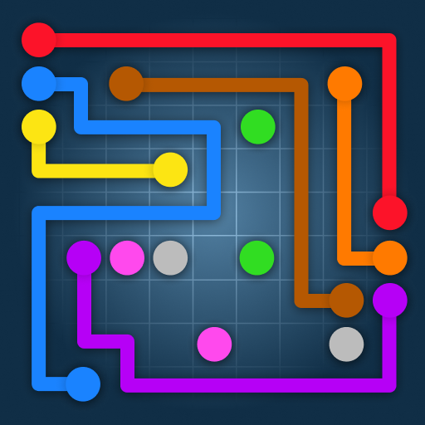
INTRODUCTION AND BACKGROUND
Android base Application
Test IQ level
Enhance cognitive Abilities

Slide 5
Overview:
Android app for IQ assessment via puzzle game.
Connect dots of same color to solve puzzles, increasing in complexity.
Benefits:
Users receive estimated IQ scores post-level completion.
Enhances analytical and problem-solving skills.
Features:
Diverse features to maintain user engagement.
Prevents boredom during gameplay.

Slide 6
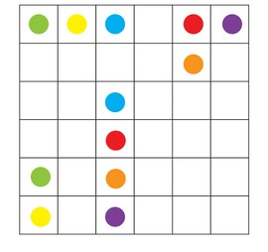
LITERATURE REVIEW
Simple Connect Dots games
No Modern Features

Slide 7
Author(s) | Game Title | Features | User Feedback | Market Positioning
Game Studios XYZ | Connect the Dots | - Simple gameplay: Connect dots of same color | - Positive: Enjoyable puzzles, addictive gameplay | - Downloads: 5 million+
 |  | - Increasing complexity: Challenging puzzles | - Negative: Some users find ads intrusive | - Rating: 4.2 stars
 |  | - Minimalist UI: Clean design for easy navigation |  | - Developed by: Game Studios XYZ
The Angry Kraken Inc. | Color Connect | - Various themes: Diverse color schemes | - Positive: Beautiful graphics, smooth gameplay | - Downloads: 2 million+
 |  | - Power-ups: Boosters to help solve puzzles | - Negative: Occasional crashes on older devices | - Rating: 4.5 stars
 |  | - Social features: Share achievements with friends |  | - Developed by: The Angry Kraken Inc.
KGS Games | Connect Dot Puzzle | - Unique mechanics: Connect dots in specific order | - Positive: Engaging puzzles, satisfying rewards | - Downloads: 1 million+
 |  | - Time challenges: Complete puzzles within time limit | - Negative: Limited hints available | - Rating: 4.0 stars
 |  | - Customization: Customize background and themes |  | - Developed by: KGS Games

Slide 8
Requirements | Angry Kraken's Color Connect | PlayValve's Connect Dots | Happy Dream's Flow Connect Dots | Connect the Color Dots (Our Game)
Gameplay Mechanics | ✅ | ✅ | ✅ | ✅
User Interface | ❌ | ✅ | ✅ | ✅
Customizability | ❌ | ❌ | ❌ | ✅
Sound Effects | ✅ | ❌ | ✅ | ✅
Feedback System | ✅ | ✅ | ✅ | ✅
Challenge Types | ✅ | ✅ | ✅ | ✅
Accessibility | ✅ | ✅ | ✅ | ✅
IQ Assessment | ❌ | ❌ | ❌ | ✅
Theme Collection | ✅ | ✅ | ✅ | ✅
Update Schedule | ❌ | ❌ | ❌ | ✅
Game Design Document Template ( Reference)

Slide 9
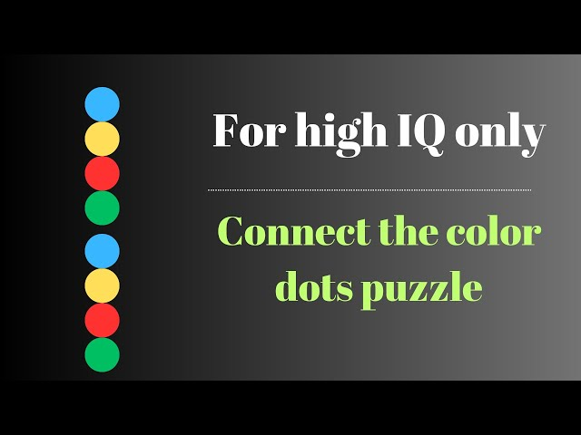
Logic building Mathematically strong Gap Analysis

Slide 10
Although many puzzle games claim to enhance cognitive abilities, most fail to directly link gameplay to IQ scores.(1,2)
Most well-known puzzle games use the same ideas and designs, without introducing anything new or inventive.(3)

Slide 11
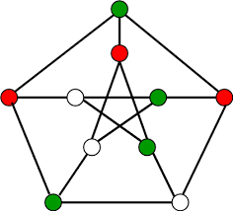
PROBLEM STATEMENT
Incorporating new features
Enhance users' skills
Logic-making abilities.

Slide 12
Challenges:
Puzzle-solving isn't universally accepted as an IQ measurement tool.
Difficult to demonstrate the value of our game without a direct IQ testing feature.
Solution:
Integrate IQ testing directly into our game.
Players can conveniently assess their IQ while playing, eliminating the need for a separate app.
Added Value:
Saves time and device storage for users.
New features enhance user entertainment and engagement.

Slide 13
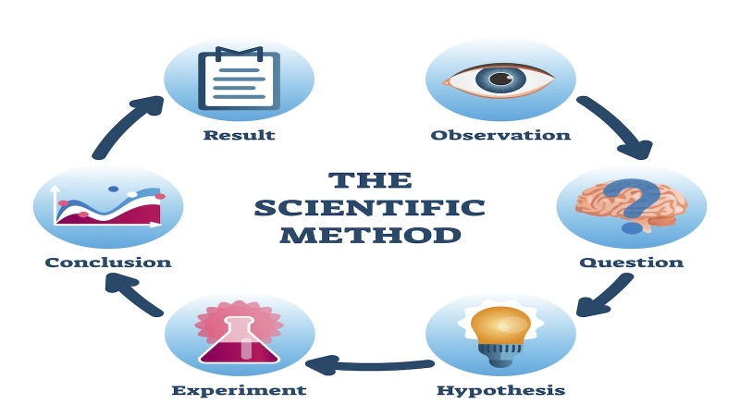
PROPOSED SOLUTION AND METHODOLOGY

Slide 14
Objective:
Create game estimating IQ from puzzle completion.
Utilize established IQ scale for scoring.
Implementation:
Design puzzles varying in complexity.
Convert completion percentiles to IQ scores.
Innovation and Expansion:
Regularly update with new puzzles and features.
Ensure game remains engaging for user retention.

Slide 15
PROJECT SCOPE

Slide 16
Define the boundaries of the project.
Including the target audience of users of all ages.
Reinforce the commitment to cater to all ages by considering ease of use and adaptability.
Focus on enhancing skills and logic through puzzle games.

Slide 17

Work Breakdown Structure

Slide 18
Break down of the project
Literature review
Understanding the problem
Gap analysis
Documentation
Prototyping
Testing

Slide 19
Roles and Responsibilities
Documentation
Development

Slide 20
Working on Documentation will be by Sulman Siddique.
Working on Development will be by Nofal Ullah and Uzair Asif.
Working on UI UX will be by Nofal Ullah and Uzair Asif.

Slide 21
Model , Algorithms and Tools
Using Agile Model
Unity 3D for developing
Figma for UI and UX
Round Robin: Managing CPU cycles among processes in Connect the Color Dots game loop, allowing smooth transitions
A*: Heuristic search finding shortest paths, applied in game pathfinding.

Slide 22
CONSTRAINTS AND LIMITATIONS

Slide 23
IQ Assessment Requirement:
Complete first level for IQ check.
Incomplete first level prevents IQ assessment.
Matrix Completion Constraint:
Fill entire grid to advance.
Failure to fill grid halts game progression.

Slide 24
https://play.google.com/store/apps/details?id=com.theangrykraken.colorconnect https://play.google.com/store/apps/details?id=com.playvalve.connect.dots https://play.google.com/store/apps/details?id=com.happydream.flow.connectdots

Slide 25


